Slide 1
Los Angeles Coastal Plain (LACP) Framework Model and Water Budget
Scott Paulinski
This information is preliminary and is subject to revision. It is being provided to meet the need for timely best science. The information is provided on the condition that neither the U.S. Geological Survey nor the U.S. Government shall be held liable for any damages resulting from the authorized or unauthorized use of the information.

Slide 2
Study Area
Los Angeles Coastal Plain (LACP)
~700 square miles of southern Los Angeles and parts of Orange County
Pacific Ocean to the west and south
Santa Monica Mtns and Puente Hills to the north
Orange County to the east
Preliminary

Slide 3
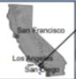
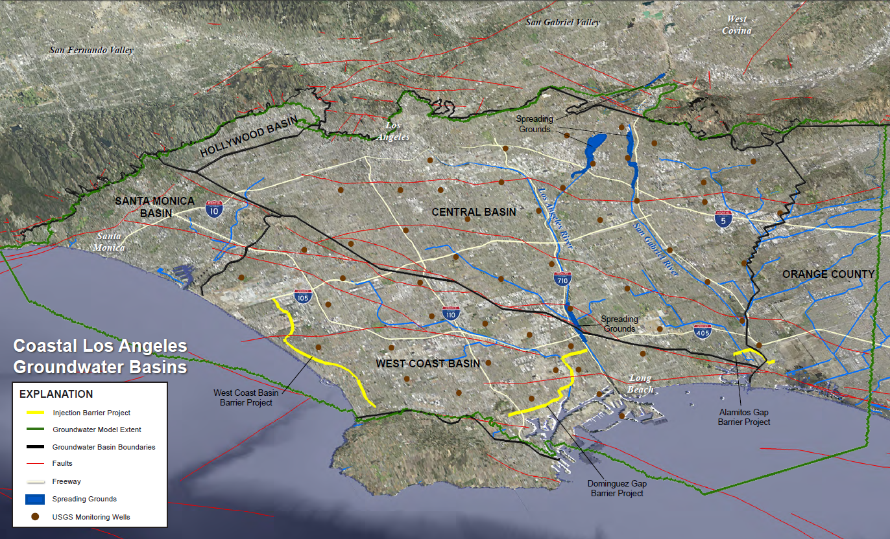
Study Area
Central, West Coast, Santa Monica, Hollywood basins, and part of Orange County basin
Preliminary
Notes:
Los Angeles Coastal Plain (LACP)
Pacific Ocean to the west and south
Santa Monica Mtns and Puente Hills to the north
Orange County to the east
Central, West Coast, Santa Monica, Hollywood basins, and part of Orange County basin

Slide 4
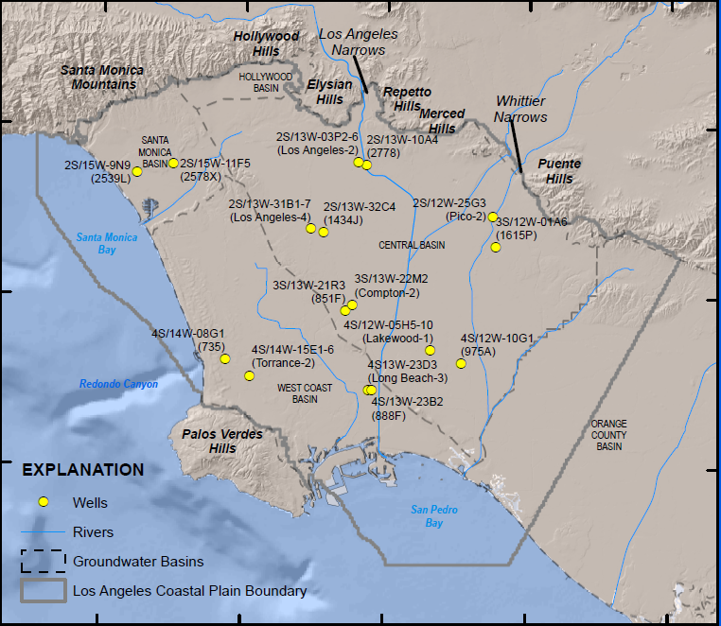
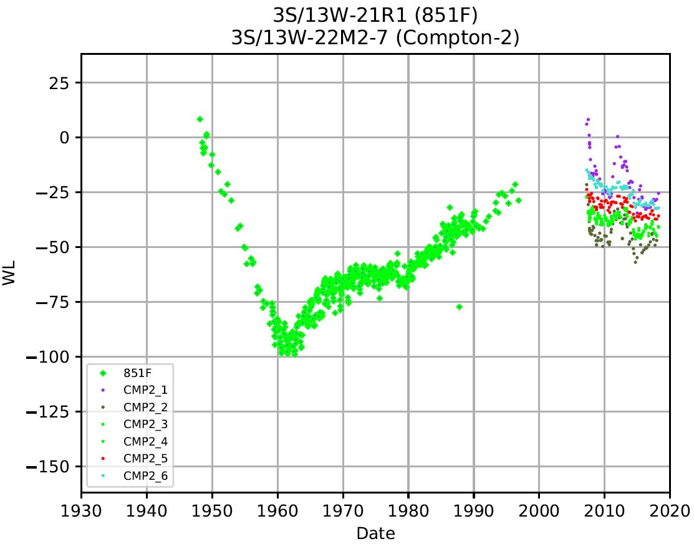
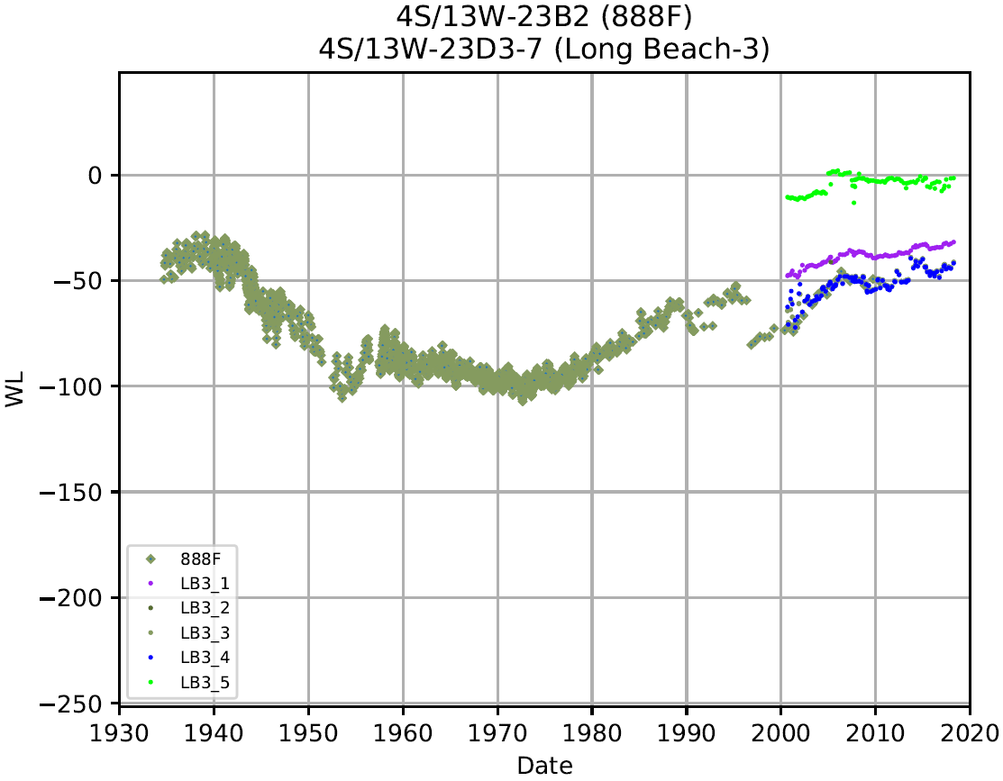
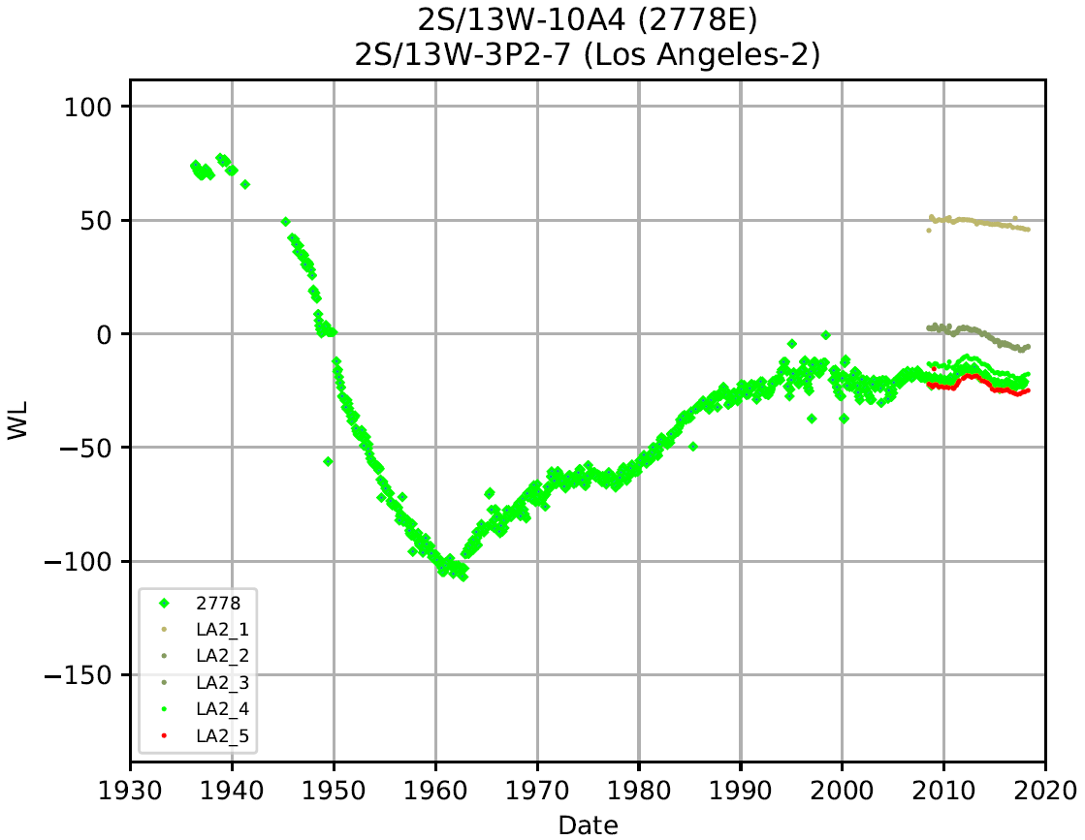
Groundwater History
Heavy pumping from 1940’s through 1960’s
Large groundwater declines
Water supply wells abandoned along coast in early 1950’s due to seawater intrusion
Water Replenishment District of Southern California (WRD) formed in 1959 to protect groundwater resources in Central and West Coast basins
Preliminary

Slide 5
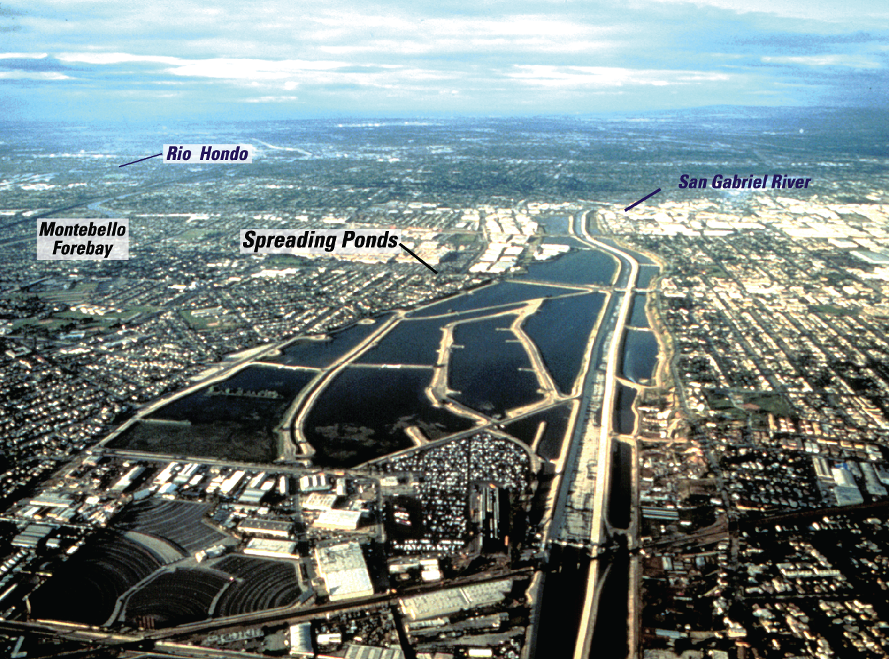
Groundwater Management
Basin management
Basin adjudicated, groundwater pumping limited
Central Basin replenished using spreading ponds along the Rio Hondo and San Gabriel River
Barrier injection wells near the coast prevent seawater intrusion
Importance of Groundwater in the LACP
Approximated 5.4 million people living on LACP
40 percent of water demand is met by groundwater in central and west coast basins
Preliminary

Slide 6
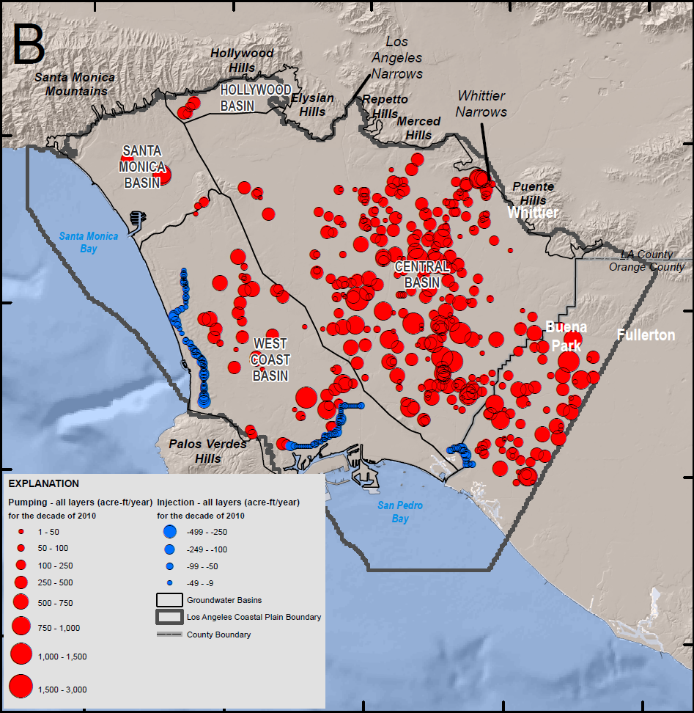
Pumping/Injection
Most pumping occurs in Central, Orange County, and West Coast Basins
Injection occurs along the West Coast Basin, Dominguez Gap, and Los Alamitos barrier projects
Preliminary

Slide 7
Study Purpose and Scope
Purpose
Provide increased scientific understanding of the hydrogeologic system of the Central and West Coast Basins that can be utilized to improve groundwater management
Scope
Hydrogeologic framework model
Rainfall-runoff-infiltration model
Conceptual model and water budget
Regional three-dimensional groundwater-flow model
Preliminary

Slide 8
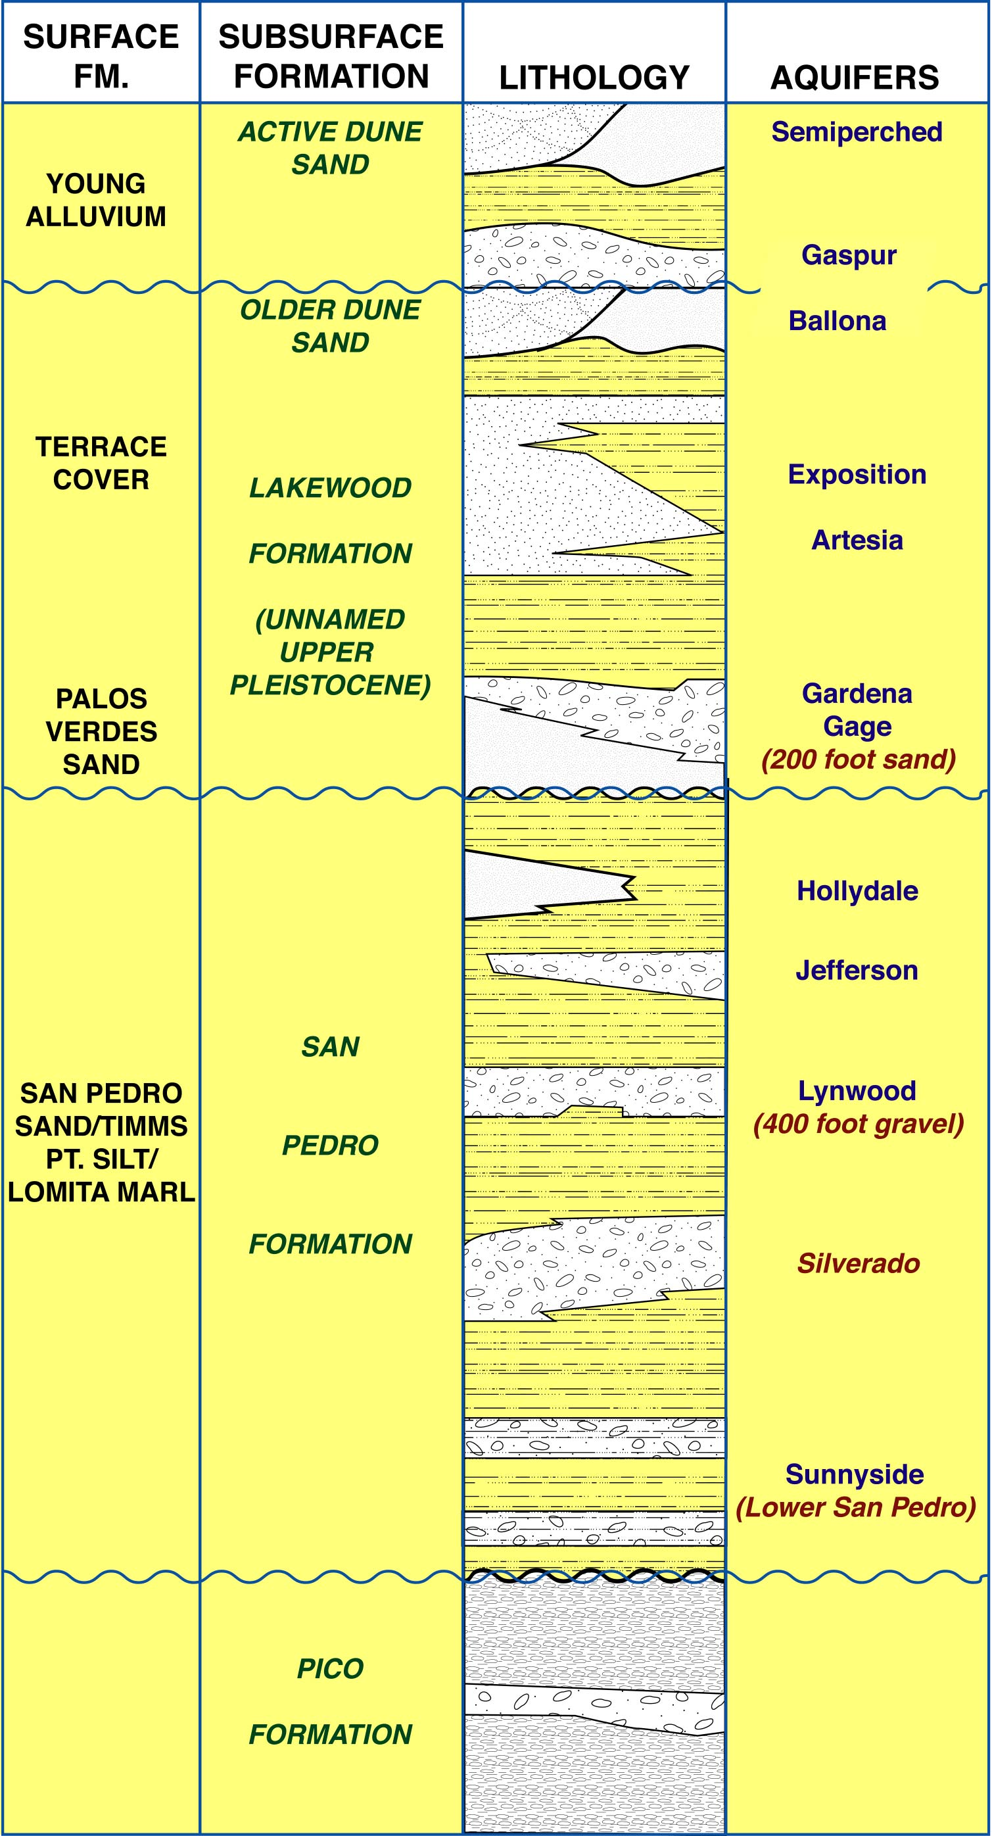
Previous Lithostratigraphic Framework Model
Previous model defined aquifers by their lithology
Aquifers were generally areas with higher concentrations of gravel and sand
Lithostratigraphic unit
A body of rocks or alluvium that is defined and recognized on the basis of its lithologic properties (ex. grain size)
Units may or may not have been deposited at the same time across their spatial extent
Preliminary

Slide 9
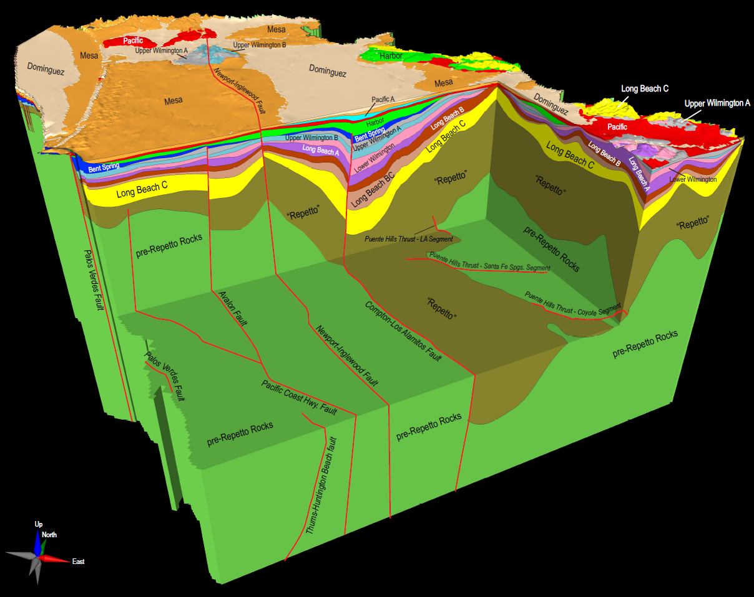
New Chronostratigraphic Framework Model
Ponti and others constructed model using Earthvision
3D model of the entire Los Angeles Coastal Plain
Thirteen layers + basement
Preliminary

Slide 10
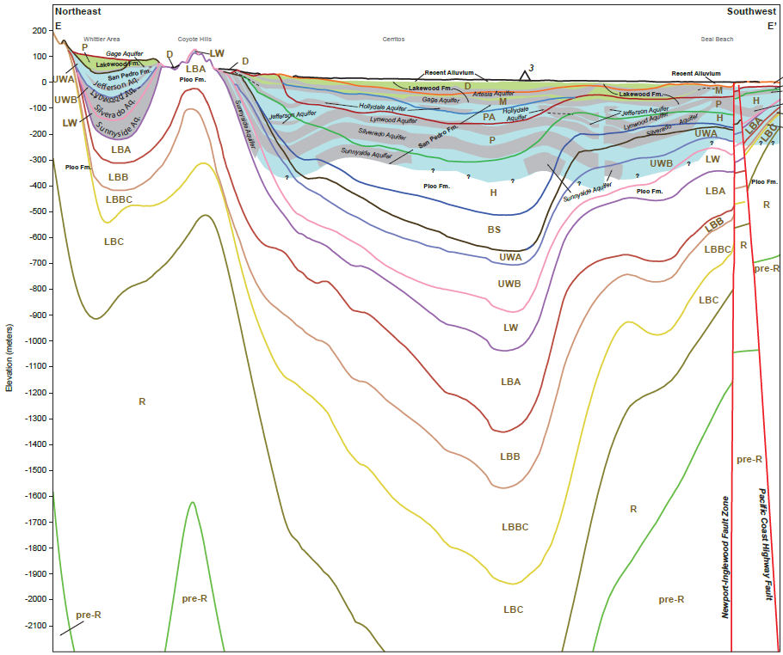
Lithostratigraphic vs. Chronostratigraphic
Chronostratigraphic units are based on time of deposition
May not follow lithostratigraphic units
Chronostratigraphic model layers reflect structure of basin
Preliminary

Slide 11
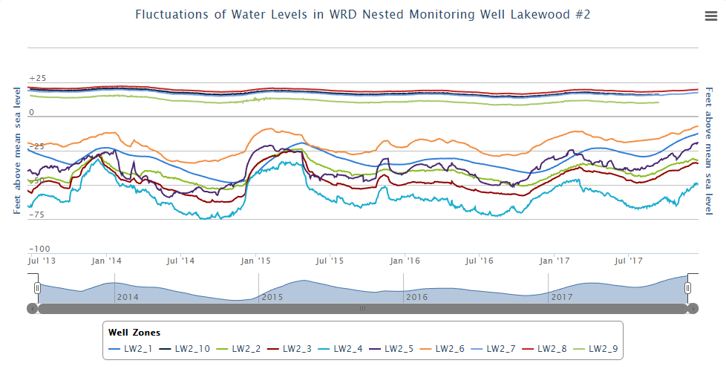
Why a new framework model?
Chronostratigraphic layers can better represent flow direction
Captures the orientation of deposits
Useful when there is high vertical anisotropy
Water level measurements showed a need for a framework model with more layers
Preliminary

Slide 12
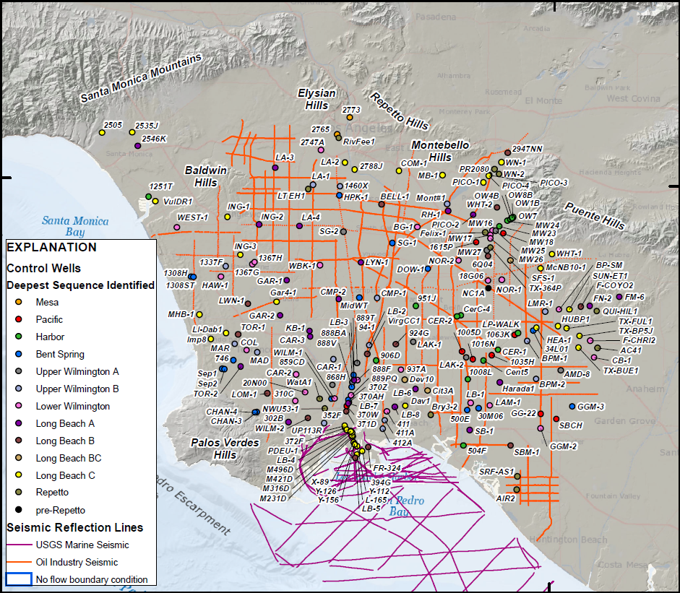
Data Used in Chronostratigraphic Model
Borehole geophysical logs
Water chemistry data
Seismic cross sections
Preliminary
Preliminary

Slide 13
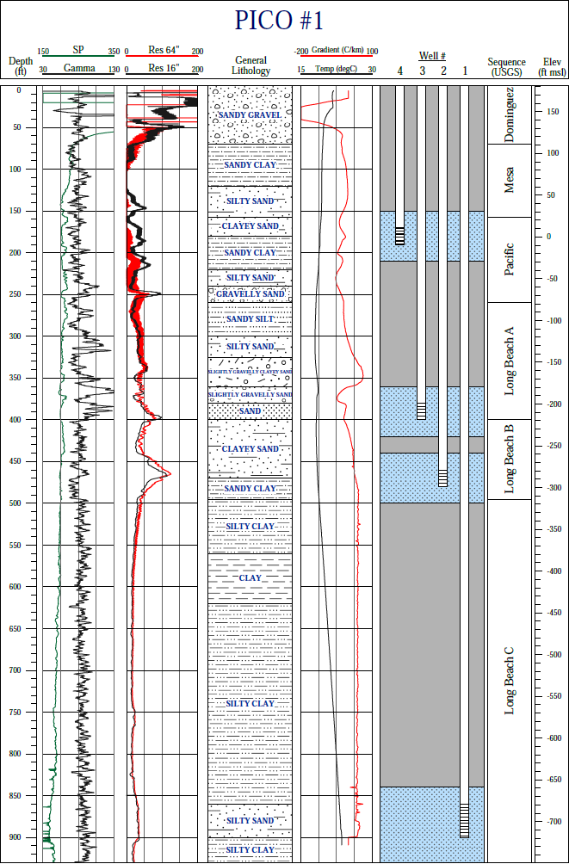
Geophysical Logs
Data types
Lithology
Resistivity
Spontaneous potential
Gamma
Nuclear magnetic resonance
Data used to
Identify boundaries between layers
Identify sediment type
Quality of data varied from well to well
Preliminary
Preliminary

Slide 14
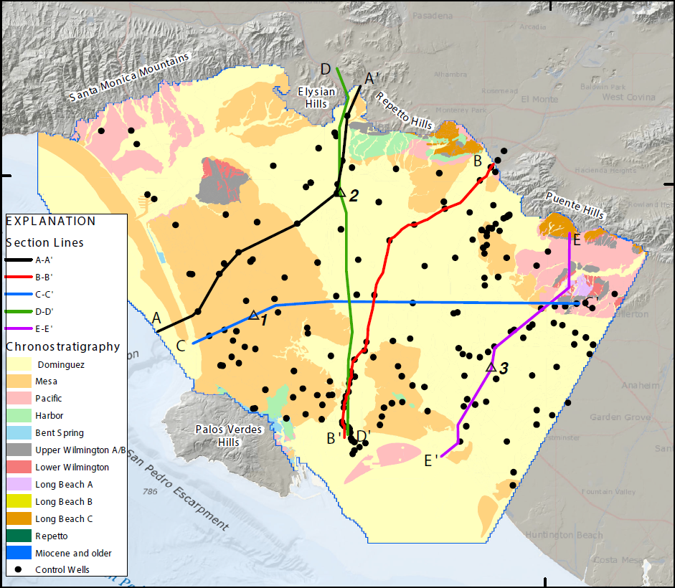
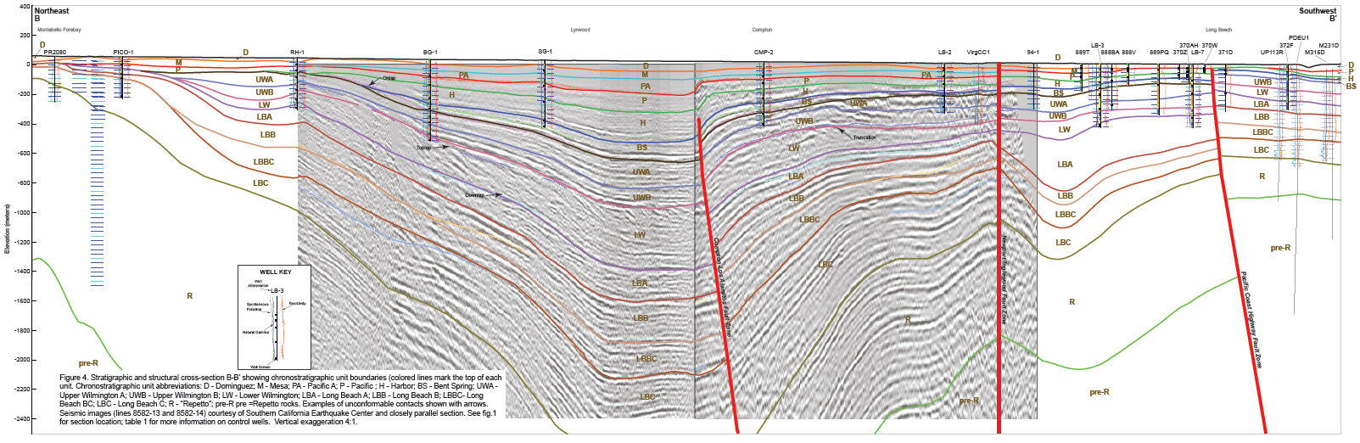
Seismic Cross Sections
Seismic cross sections can show the structure of a cross sectional area
Chronostratigraphic unit boundaries tend follow that structure
Preliminary

Slide 15
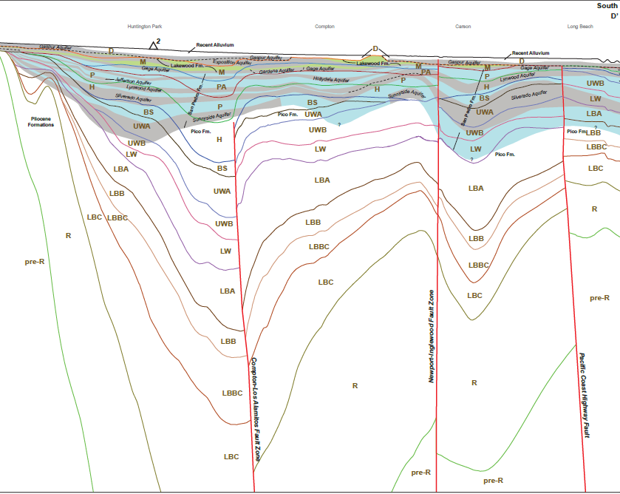
Faulting in New Chronostratigraphic Model
Model includes which layers each fault cuts and the amount each layer is offset
Faults determined from a variety of sources including seismic lines and previous studies
Preliminary

Slide 16
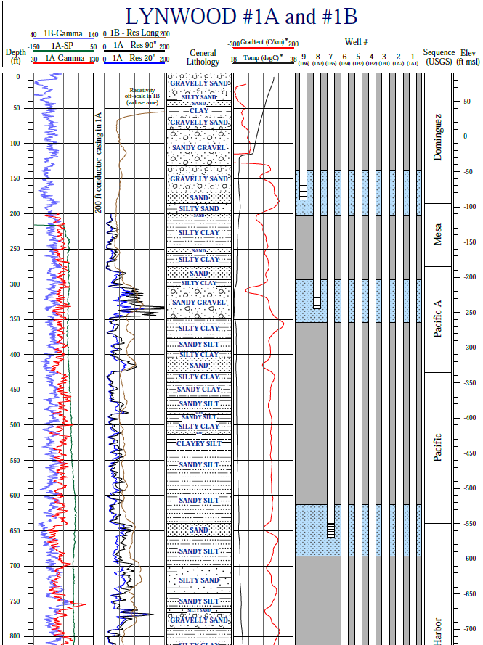
Grain Size Analysis
Lithology, resistivity, gamma, and nuclear magnetic resonance (NMR) data used to approximate grain size
Lithology
Gravel and sand coarse
Silt and clay fine
Resistivity
Usually higher resistivity in coarser sediments
Gamma
Usually higher gamma in clays
NMR
NMR can estimate permeability
Preliminary

Slide 17
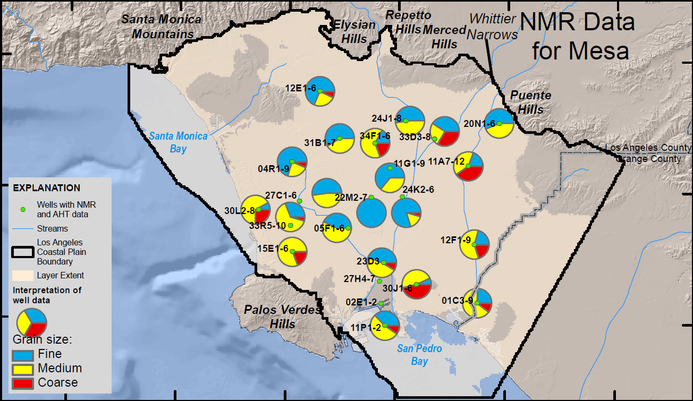
Grain Size Analysis Results
Amount of coarse, medium and fine grained sediment determined
At each borehole
For each layer
Preliminary

Slide 18
Questions Framework Model and Grain Analysis Can Help Answer
How should we layer our groundwater model to best model groundwater flow in the study area?
How many layers?
What are the extent of the layers?
How thick are the layers?
Are there any flow barriers in the model and where should they go?
Where are the faults and what layers do the faults cut across?
What are the hydraulic properties of our groundwater model?
How easily does groundwater flow through the different layers?
How easily does groundwater flow vertically vs horizontally?
Preliminary

Slide 19
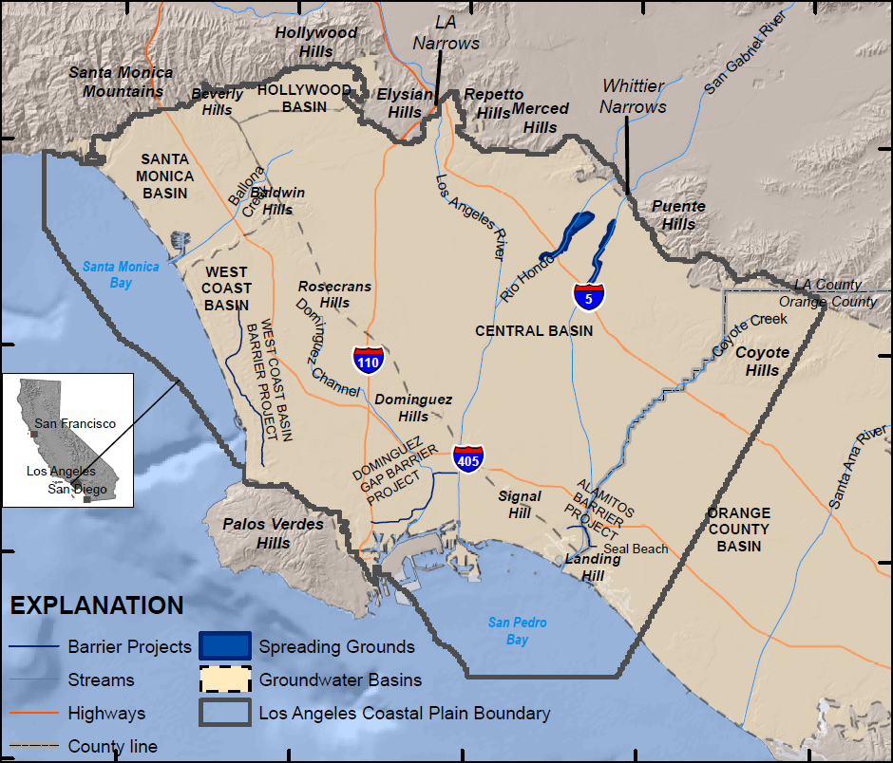
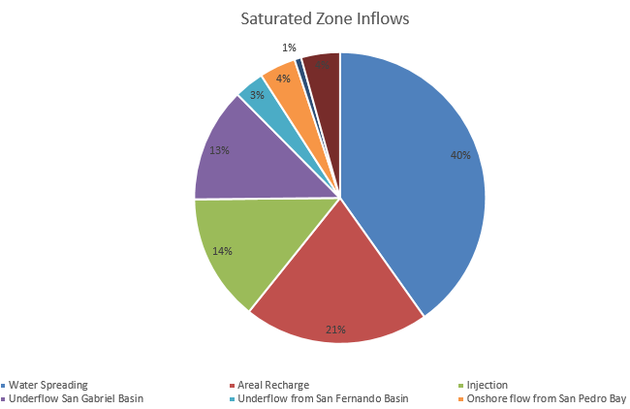
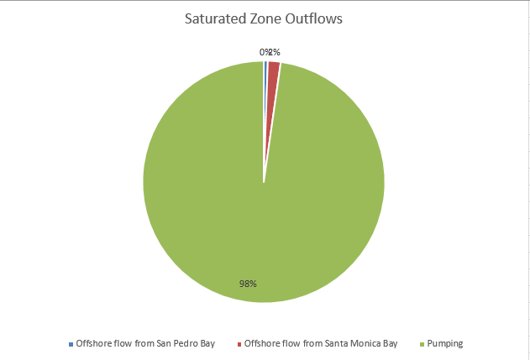
LACP Water Budget
Water spreading
Precipitation and mountain front recharge
Injection
Flow in/out of the study area
Pumping
Preliminary

Slide 20
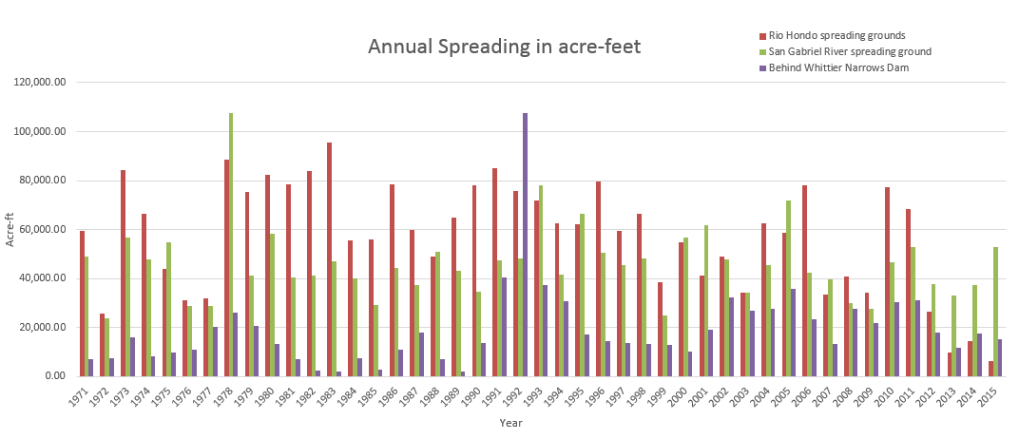
Water Spreading
Spreading grounds
High permeability areas where water percolates into groundwater basins
Located at San Gabriel River, Rio Hondo, and Whittier Narrows Dam
Preliminary

Slide 21
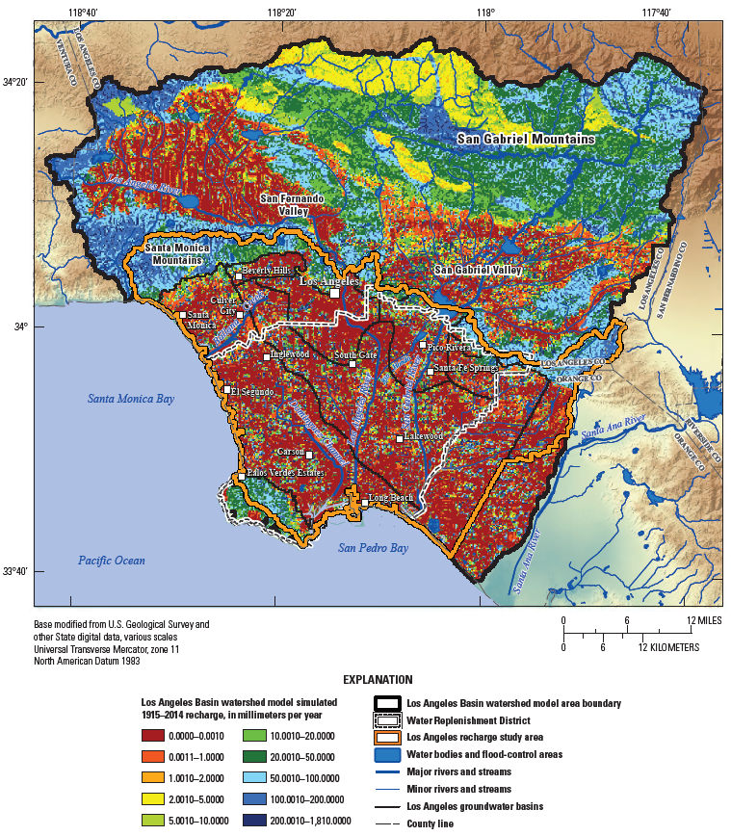
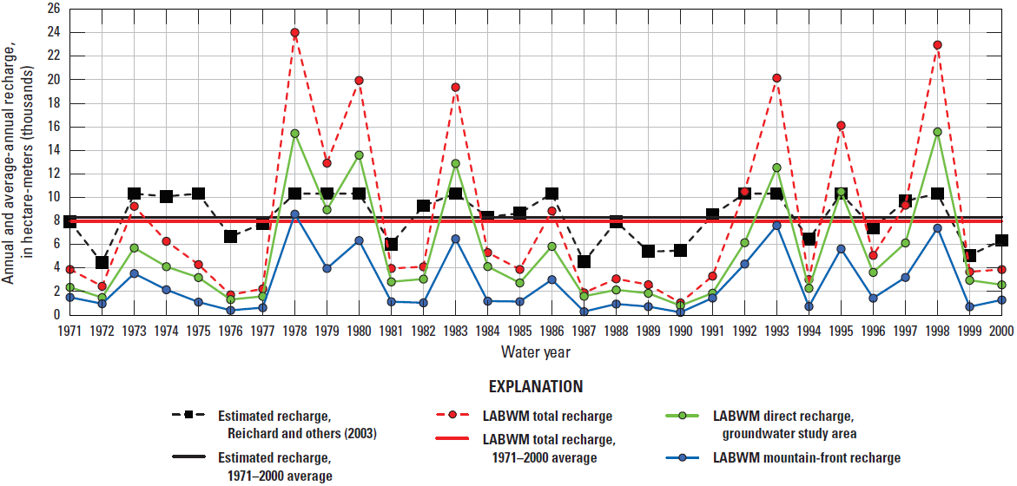
Precipitation and Mountain Front Recharge
Recharge estimates from Hevesi and others, 2016
Done with INFIL
Modeled both precipitation and mountain front recharge
Time varying recharge estimates
Hevesi, J.A., and Johnson, T.D., 2016, Estimating spatially and temporally varying recharge and runoff from precipitation and urban irrigation in the Los Angeles Basin, California: U.S. Geological Survey Scientific Investigations Report 2016–5068, 192 p., http://dx.doi.org/10.3133/sir20165068.
Preliminary

Slide 22
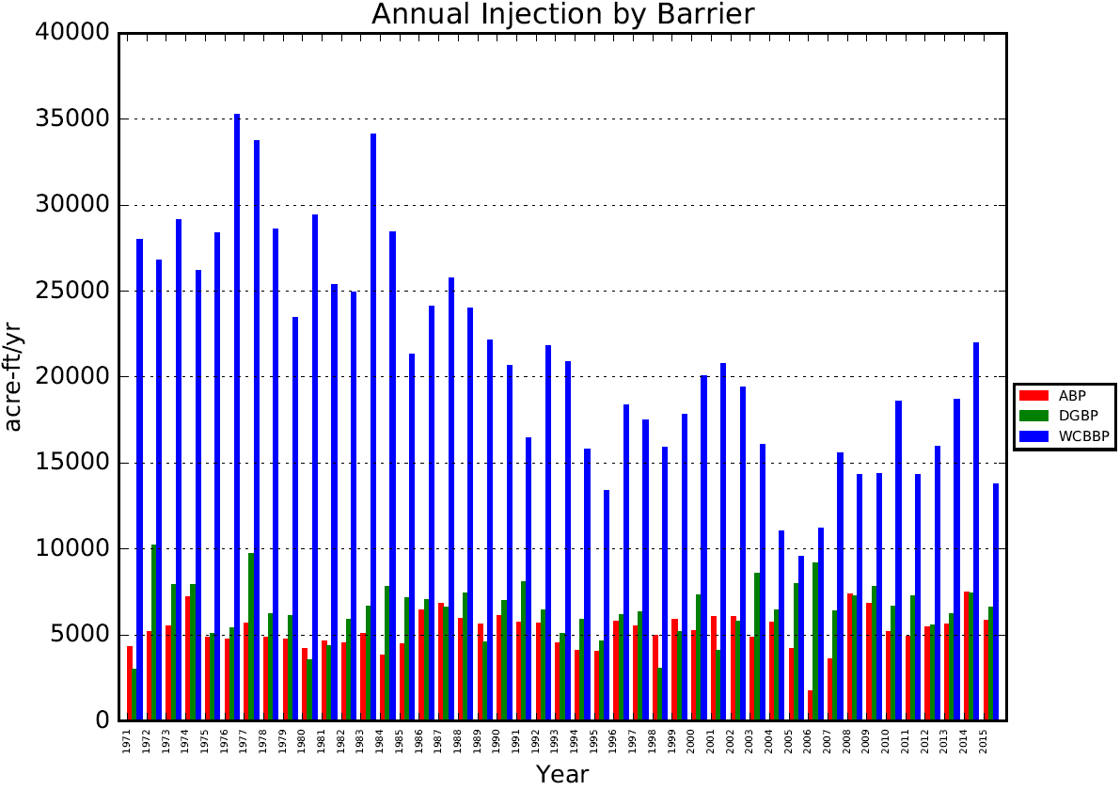
Barrier Injection Projects
Injection at three barrier projects along the coast
West Coast Basin Barrier Project
Dominguez Gap Barrier Project
Alamitos Barrier Project
Preliminary

Slide 23
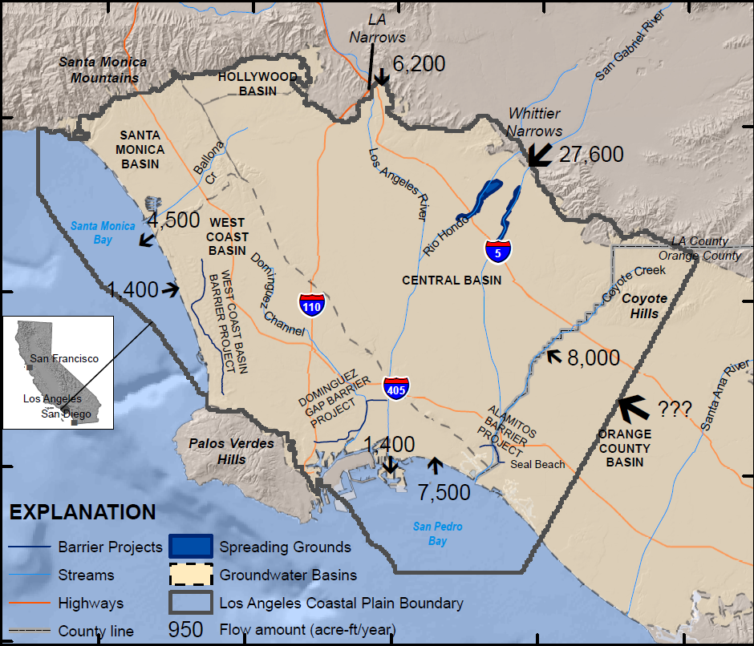
Estimated Average Flow In/Out of Study Area (1971-2015)
Estimates based on
Previous groundwater model
San Gabriel River Watermaster estimate
Some estimates are better than others
Orange county boundary estimate
Preliminary

Slide 24
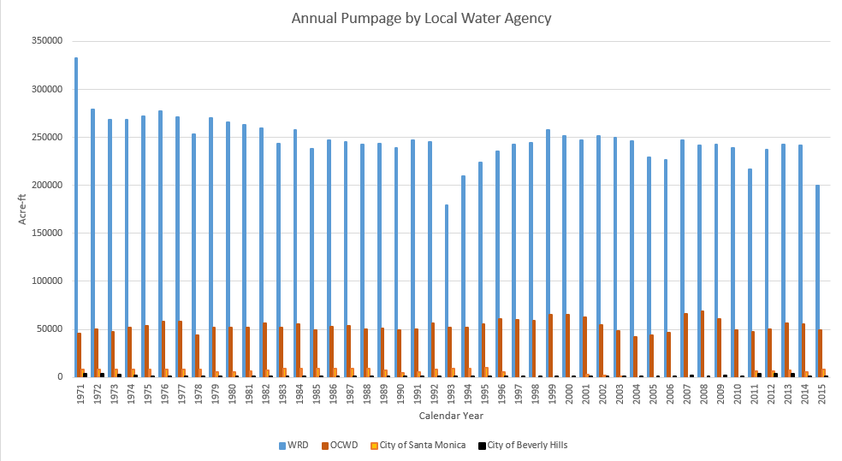
Pumping by Agency
Four different agency managing pumping in the LACP
WRD manages the majority of the LACP
Preliminary

Slide 25
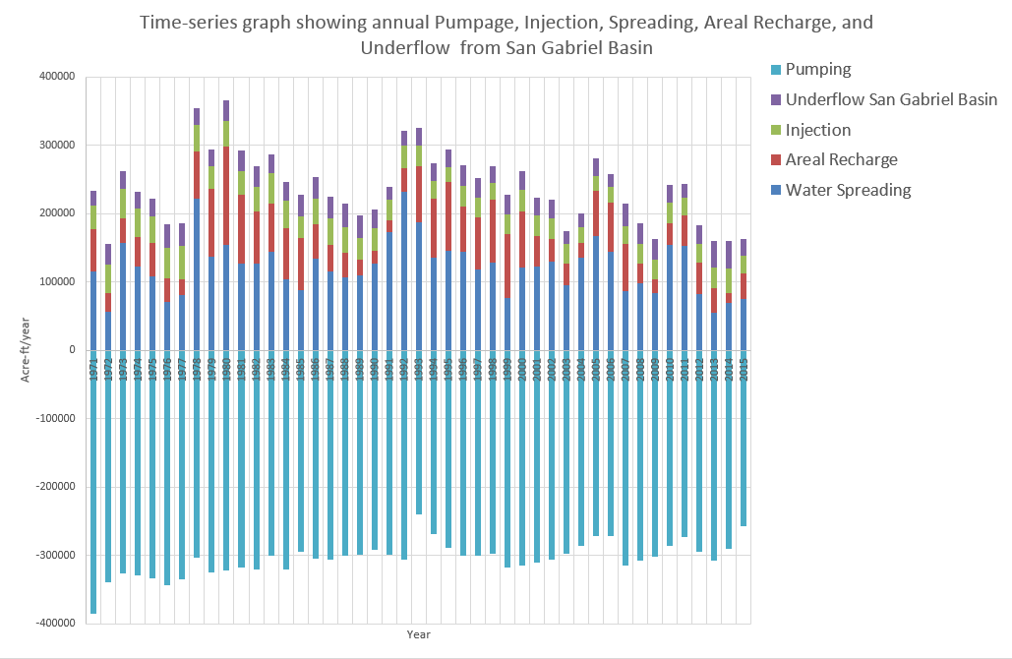
Water Budget Through Time
Pumping fairly constant due to basin adjudication
Water spreading and areal recharge variable
Preliminary

Slide 26
Questions Water Budget Can Help Answer
How to construct our groundwater model’s boundary conditions?
Where is groundwater entering and leaving the study area?
How much water is entering and leaving?
How to model areal recharge?
How much precipitation is recharging the groundwater basin?
How to model pumping, injection, and water spreading?
How much pumping, injection, and water spreading is there?
Preliminary

Slide 27
Summary
LACP is a highly populated area with a significant reliance on groundwater
An understanding of groundwater flow is needed for management of these heavily pumped and complex groundwater basins
Hydrogeologic framework, rainfall, and conceptual models are important first steps to better understanding groundwater flow
These models were used in the construction of an updated groundwater flow model
Preliminary

Slide 28
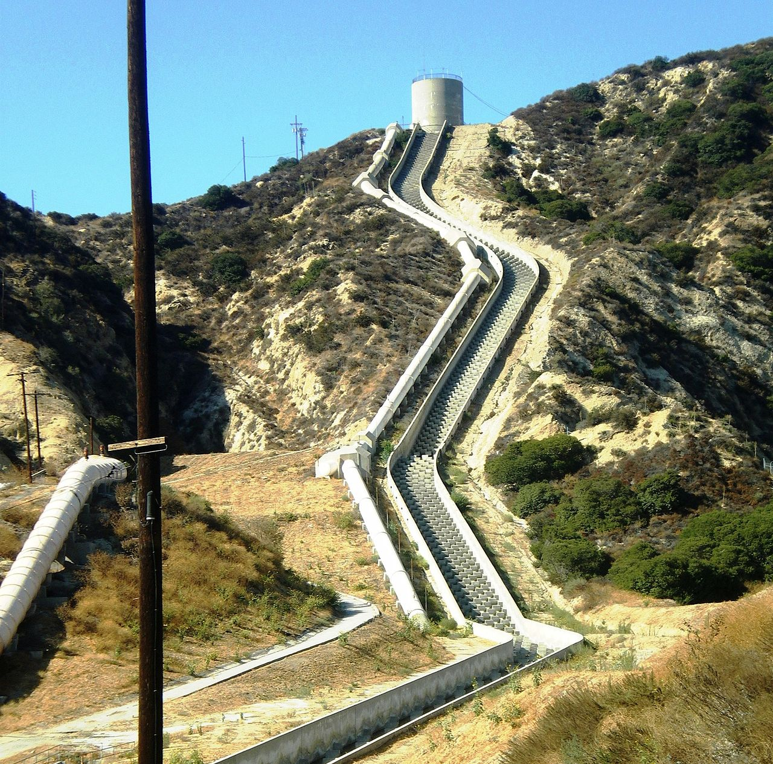
Questions?

